Slide 1
Suicidal Catalysts
Ish Gupta

Slide 2

Anyone who has Born, has to Die! Everyone has their own Excuse of giving up this Life.
Many of them happen due to Health reasons, or Natural Calamities, like Earthquake or Havocs, etc. But, there are also Incidents when people give up on their Life willingly. Yes, they commit SUICIDE!
What are the possible factors, that lead them to take such an Action?
Is it because of Financial Reasons, Health Issues, being Alone, or Personal Tragedies.

Slide 3
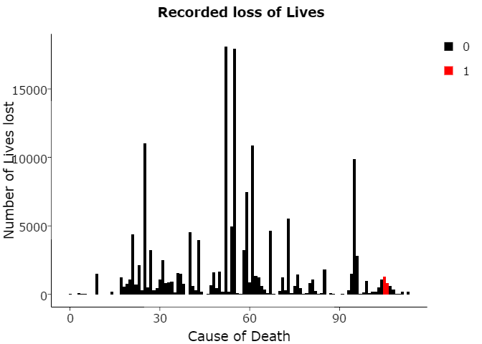
Notes:
National Longitudinal Mortality Survey was a follow up done with a set of population (living in United States) for 11 years time, to observe and record their Health and Lifestyle vitals to study the effects of demographic and socio-economic characteristics on differential in Mortality rates.

Slide 4
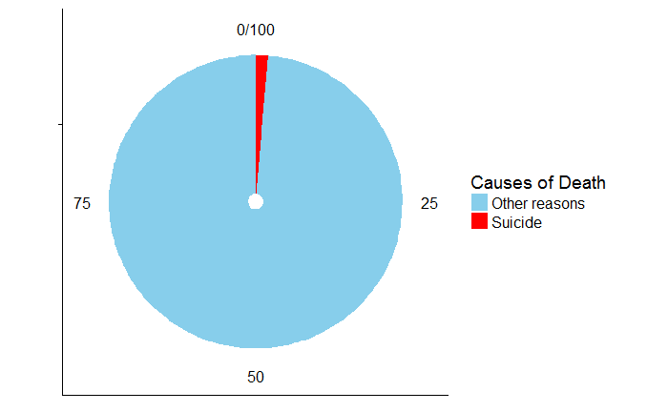
Notes:
The Study had recorded over 113 causes of Death, out of which 1.33% Deaths are because of Suicides.

Slide 5
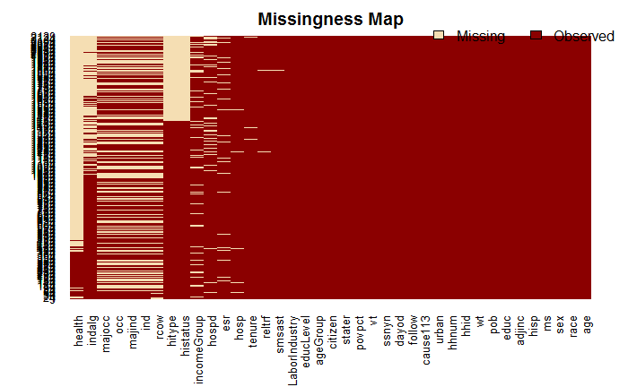
Is each Factor a Catalyst?
Notes:
Out of 39 Factors recorded for each Individual, not each one of them drives towards the Intention of an Individual trying to end his Life. We’ll start with those, which seem to driving the Course.

Slide 6
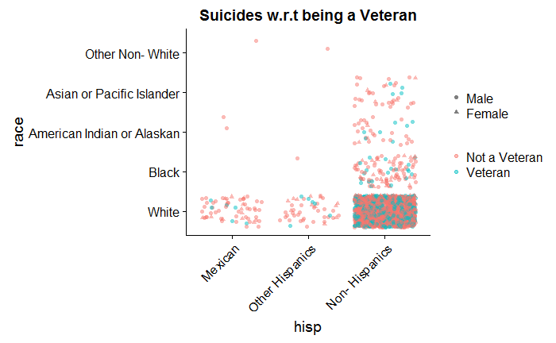
Is being a Veteran a reason?
Notes:
Most of the Suicides have been found by people who are not a member of any Defense Forces.

Slide 7
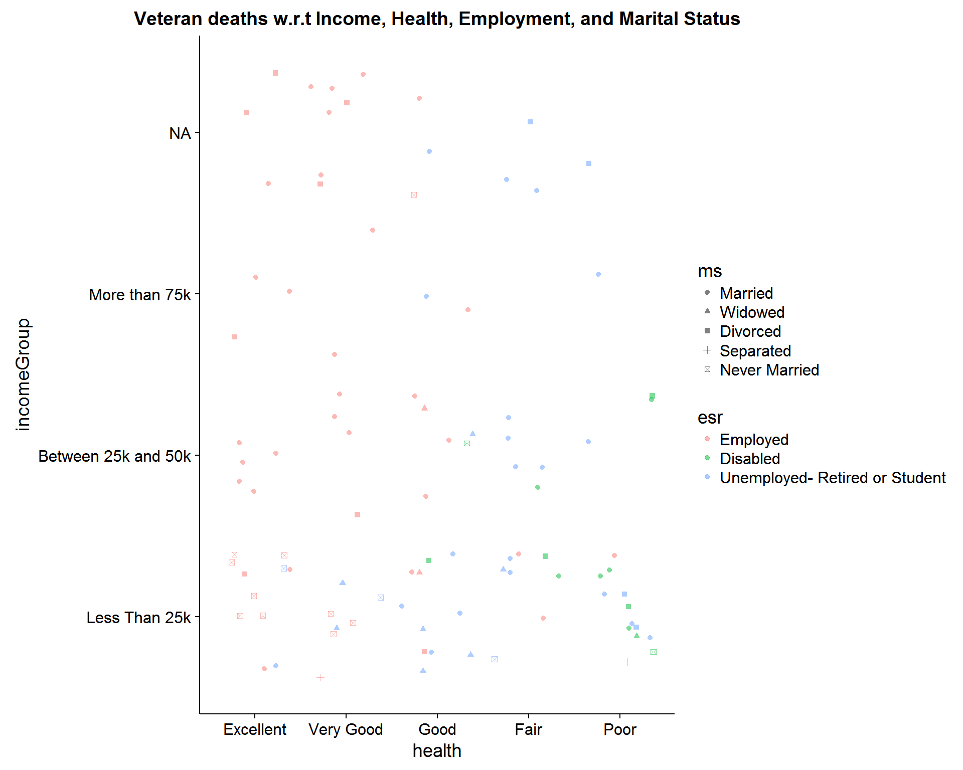
Notes:
People below age of 35 years, having Excellent health, may be facing difficulties with their Intellectual Health.
Can Government authorities do something here by initiating a Counseling with the Veterans to help them out?
Disabled people with Poor Health also seem to be contributing towards Suicide.
Their Disability be due to any harm for their participation in any War. Could Government authorities taking better Care of them help out from losing their Lives?
People with Income < 25k form the majority.
Could Government increasing their Wages help them out from taking such actions?
Never Married, and Separated are the least amongst Veterans.
Could Marriages, losing the Partner or divorce be a factor leading People into some personal issues, eventually taking a toll on mental Health? If yes, Married/ Divorced/ Widowed people could be focused to undergo some Counseling sessions to help them out.

Slide 8
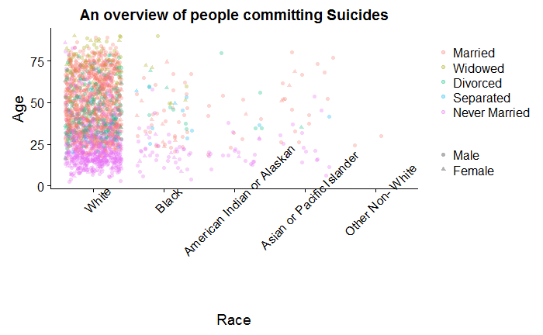
Notes:
Whites have been the most out of Subjects committing Suicides, evenly spread across all Age Groups.
Males are found to be in majority for committing Suicides, with White, Married, and Never Married topping the census. We’ll study the individual contribution of these factors towards deducing the Survivability of any Subject.

Slide 9
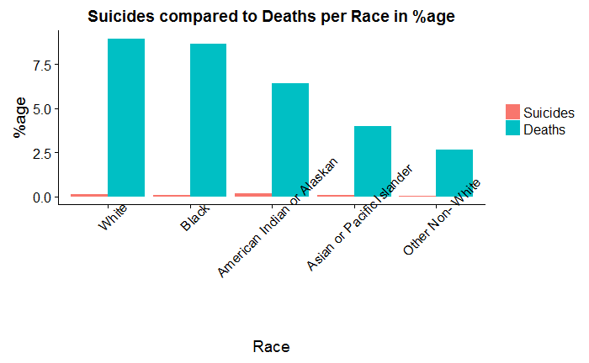
How does Race drive people towards Suicide?
Notes:
The data shows that Whites are the ones committing most of the Suicides, but comparatively there is more %age of the 'American Indian or Alaskan' population committing Suicides.

Slide 10
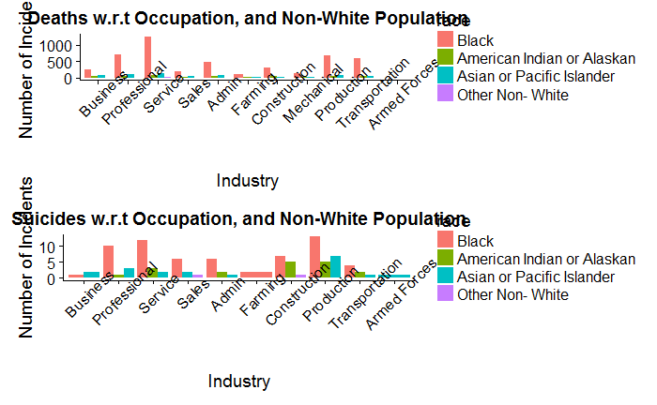
Occupation, Location, Race

Slide 11
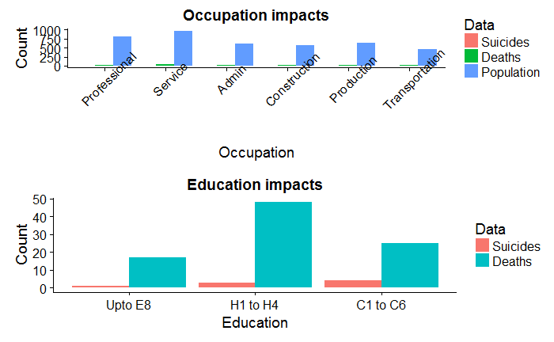
Occupation, Education comparison
Notes:
There are 2 areas- Service, and Production which should be looked into for the maximum number of Deaths, and Suicides, respectively.
American Indian or Alaskan people have committed most of the Suicides in Production, and Construction related Work areas.
However, American Indians or Alaskans did not commit Suicide who worked for Business, Sales, Farming, and Armed Forces. People educated till High School level 4 and having Salary less than 25k are the majority among Subjects.

Slide 12
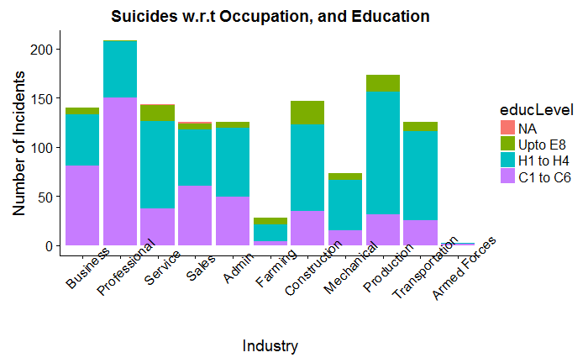
Does Education help people in reducing Suicides?
Notes:
People with High School Education of level- H1 to H4 can be found in every Profession. But, most of them losing their Lives are in Construction, and Transportation Business.
Also, people with higher Education level of C1 to C6 are least involved in Farming Business, maybe because they move to Metro cities.
And most of them (Engineers, Scientists, Lawyers, Judicial Workers, Judges, Teachers, Musicians, Artists, Photographers, Doctors, Pharmacists).
Could this be because of Work pressure they have to bear because of an higher level of Job they are pursuing?
Could it be helpful to incorporate a Subject in the Education System, which could help people understand and manage Mental pressures?
Majority of the Subjects had Insurance subscribed from their Employer.

Slide 13
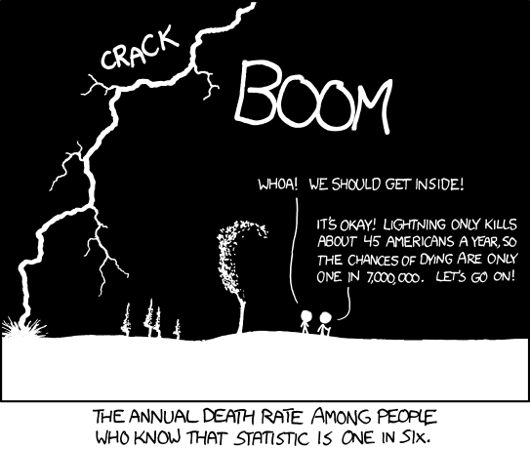
Survival Analysis of Suicides.
Notes:
Survival Analysis provides a set of methods to analyze the Loss of Lives to know the proportion of Population that’ll survive at a certain point of time, How does any Factor increase or decrease the probability of Survival?

Slide 14
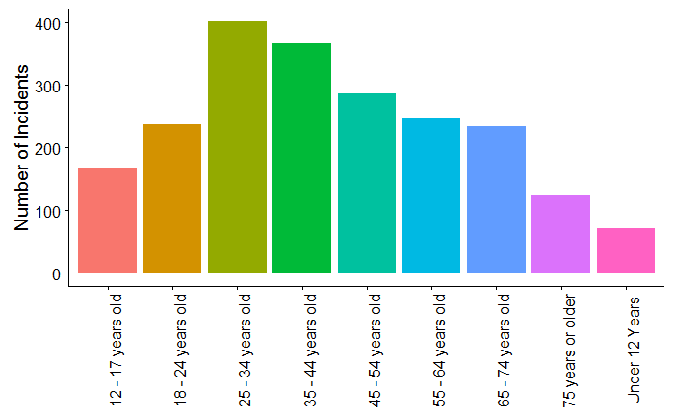
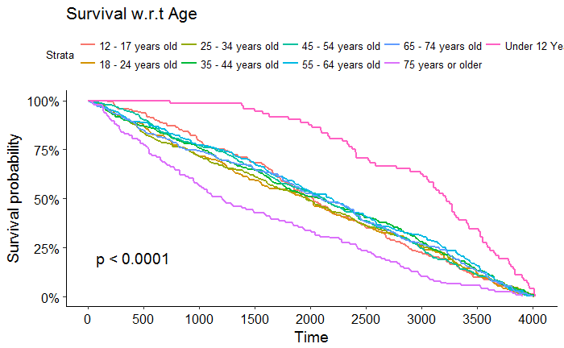
How does Age actually impact?
Notes:
People in age group > 75 years are found to be most Vulnerable of commiting Suicides. However, Youth in age group of 25 - 34 Years, are the majority in Count of commiting Suicides.

Slide 15
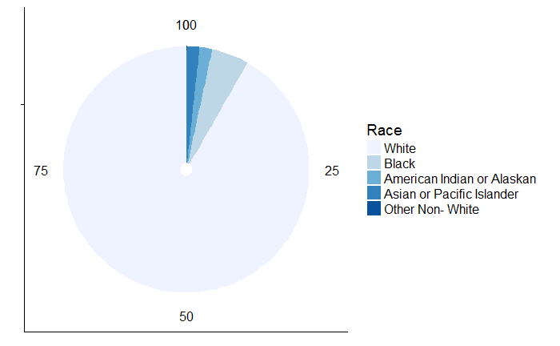
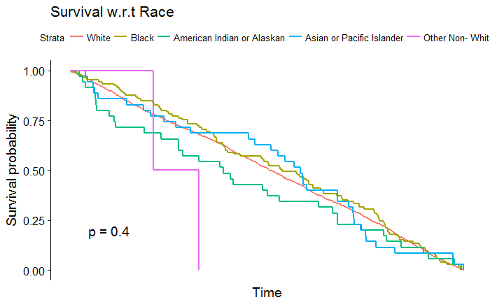
Race impacts
Notes:
People of Race = Other Non- White are most vulnerable towards committing Suicides, but Suicides appear to be in majority among the Whites.
Whereas, comparatively, “American Indian or Alaskan” commits most of the Suicides proportionally.

Slide 16
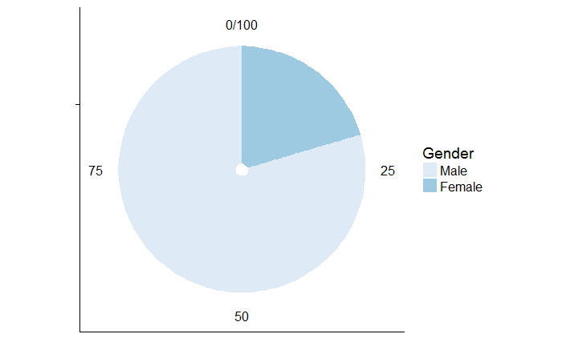
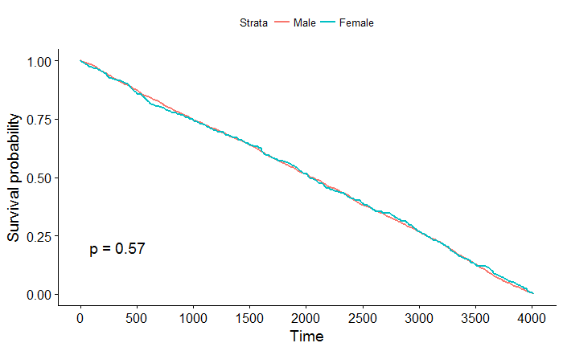
Inclination to loss w.r.t Gender
Notes:
Males or Females are equally vulnerable towards commiting Suicide, but Males outnumber Females for the Stats.

Slide 17

How does getting married impact?
Notes:
Let’s check out the impacts of getting Married, or staying a Bachelor drives people’s instincts towards Suicide.

Slide 18
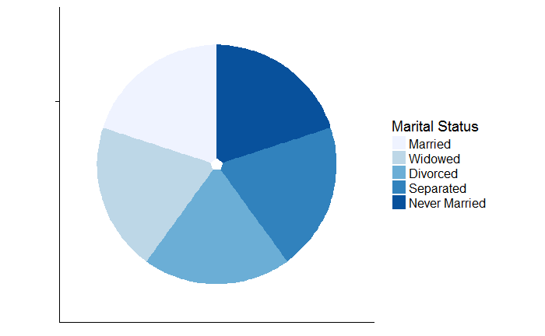
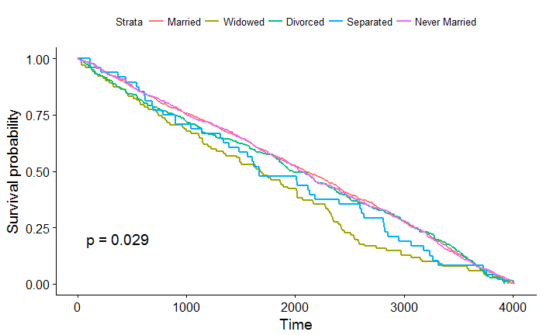
Notes:
Subjects consist of majorly Married people, but Widowed are ones most Vulnerable.

Slide 19
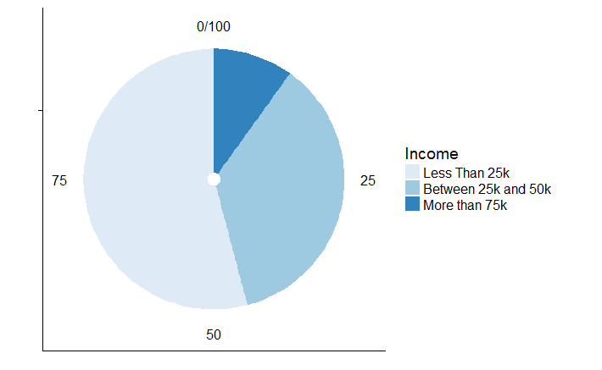
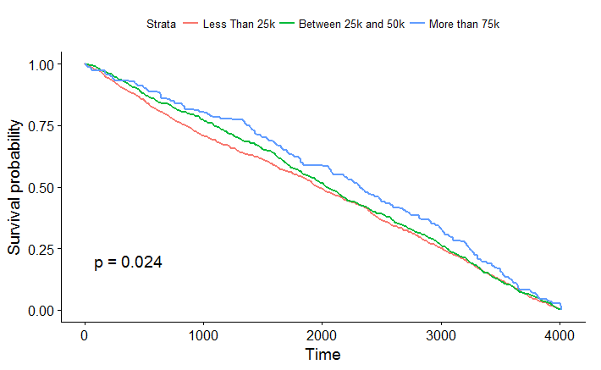
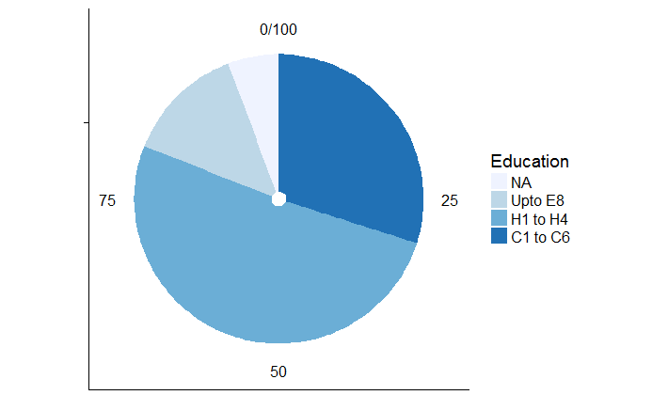
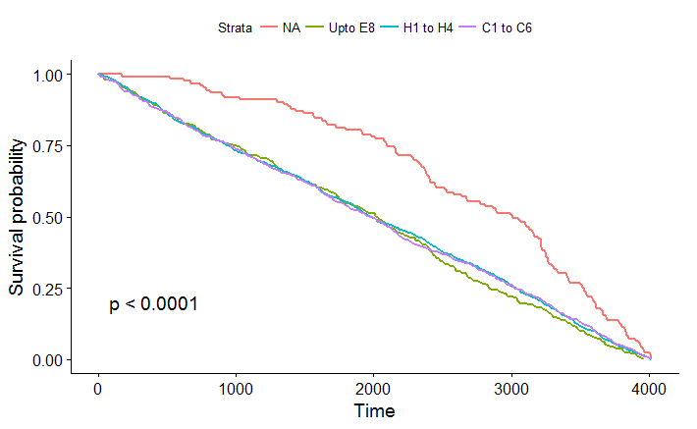
Education, Income Face Off!

Slide 20
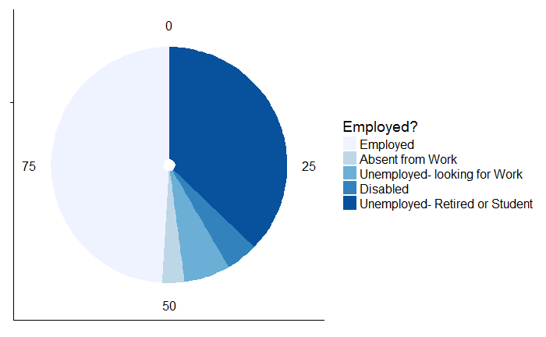
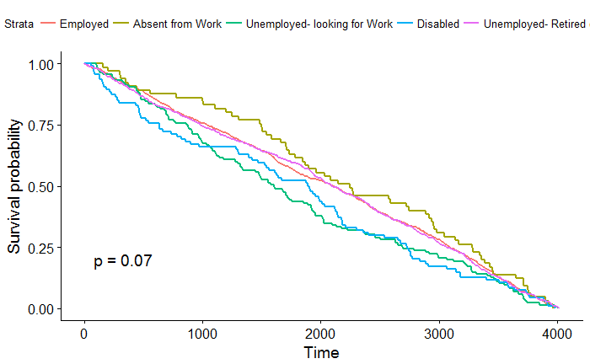
Are they more of Working people, or the Unemployed?
Notes:
As we can see, most of the Subjects are those having a Job to work in.
Employed people are those who form the majority for People with Best health conditions.
Overall Deaths have been recorded for the Unemployed population, but Suicides are most committed by the Working Community.
Could the Work pressure be driving this much of people towards Suicide?

Slide 21
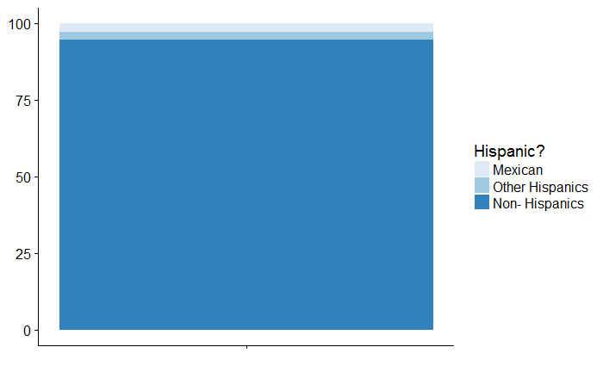
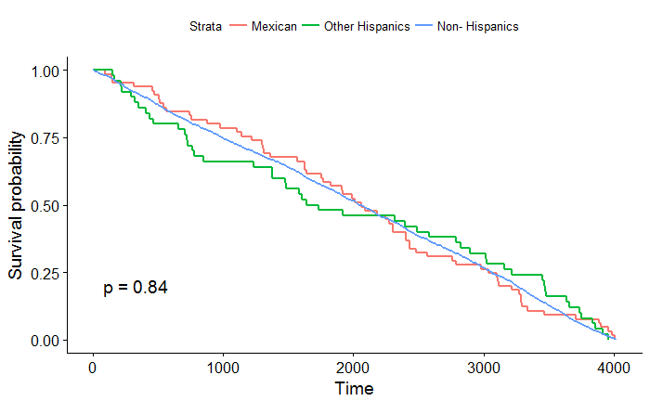
Hispanic vs Native?

Slide 22
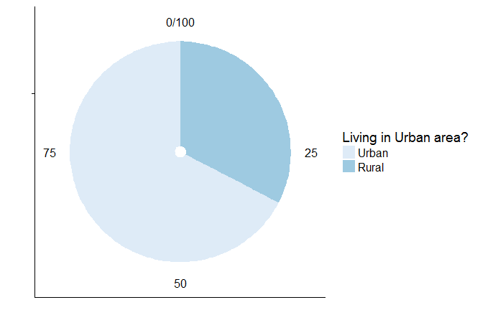
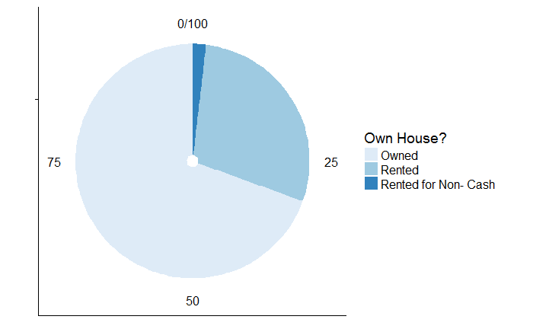
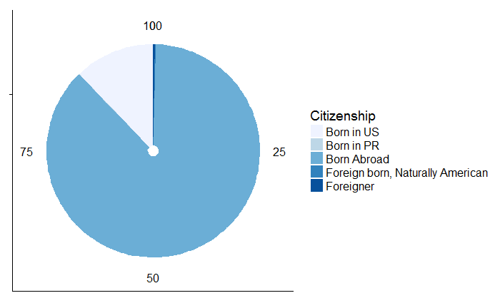
Living in Urban area, own House a reason?
Notes:
People living in Urban areas outnumber Rural population for Suicides.
Subjects living in their Own Houses have been found in majority, whereas all are equally vulnerable towards committing the Act.
People born in US are less resilient against Suicide, and are outnumbered by people Born Abroad.

Slide 23
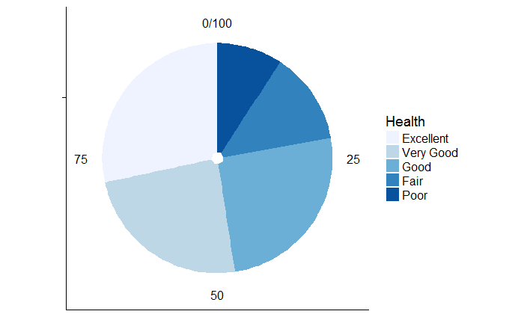
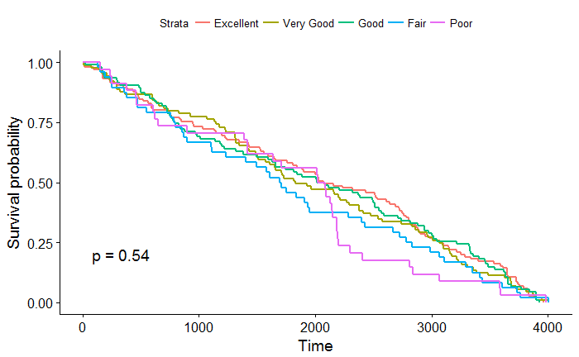
Why do Healthy people commit Suicide?
Notes:
People with average health are least resilient but are outnumbered by people with Excellent Health.
Healthy people committing Suicide must be counseled for they being definitely doing it against some Personal Tragedies.

Slide 24

For all the factors that drive people towards Suicide, Government could launch some Counseling campaigns to locate and help such people in a way helpful for their respective reasons.

